Slide 1
ALL About me
Michael Amoo
Notes:
My Family and I are unique.

Slide 2
This is about me
Where are you from?
Suffolk, Virginia
What is your family makeup? Who is in your household?
My mom, sister, me and my brother. All of them are in the household
What do you do in your spare time?
Read
Sleep
Play games

Slide 3
Hampton University
Everyday Pictures on campus

Slide 4
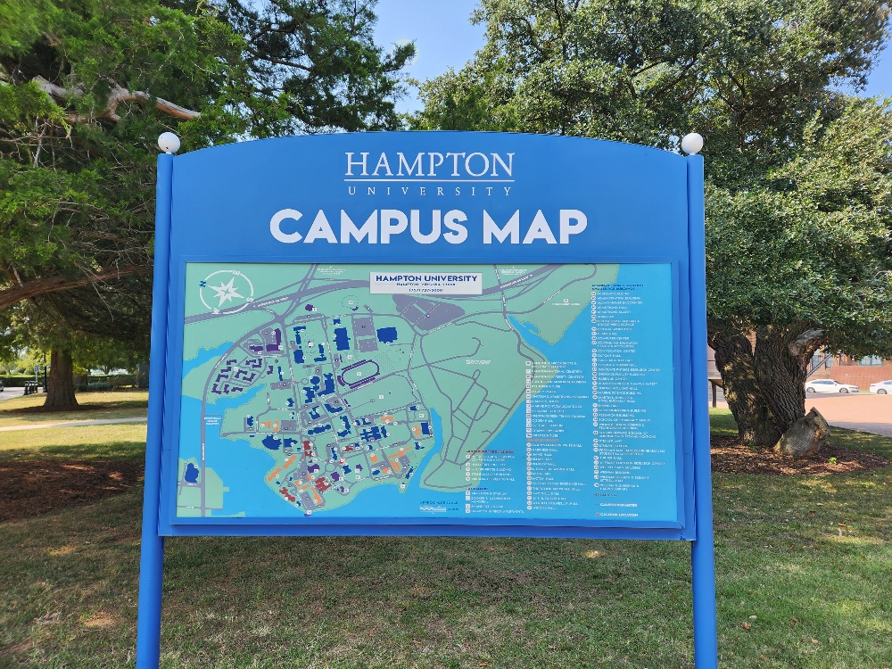
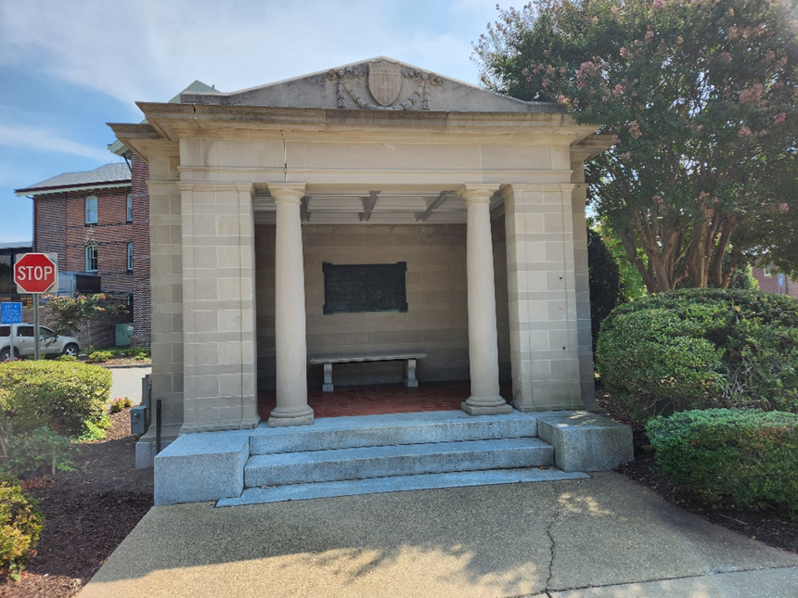

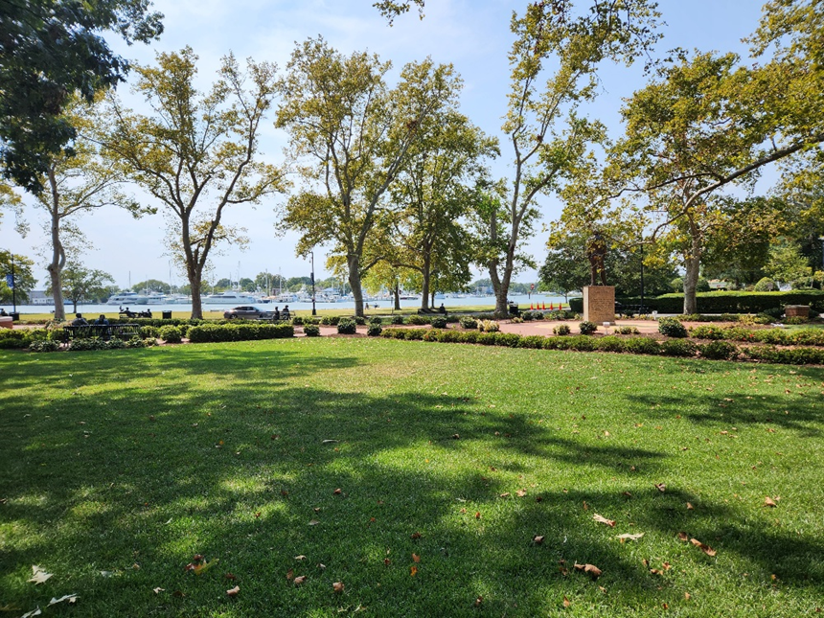
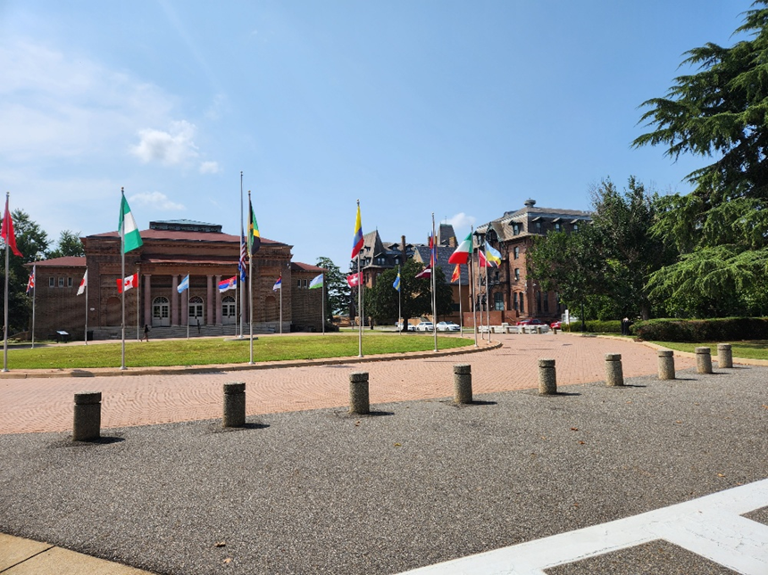

Slide 5




Slide 7

Sleep heals the soul
It puts me at ease

Slide 8
“That’s Crazy”

Slide 9
Agenda
Meet & greet with family
Visit the museum
Visit the Convocation Center
Lunch and Parent-Child Expectations
Visit the President
Visit the Theatre

Slide 10
Administrators
Professors
Chairs
Deans

Slide 11
Evening events
Event | Location | Time
Choir | Theatre | 2:30-3:30 p.m.
Play | Theatre | 3:30-4:30 p.m.
Game | Stadium | 4:45-5:45 p.m.
Dinner | Convocation Center | 6:00-8:00 p.m.
This game will be canceled in the event of inclement weather!

Slide 12
HU2024 Football Attendance

Slide 13
Top Five Reasons for Choosing Hampton University

Slide 14
My Intro to Computers Class
CSC 120 35 – Tonja Owens

Slide 15
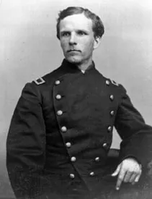
Samuel C. Armstrong
Founder of Hampton Normal and Agricultural Institute
Renamed Hampton Institute
Renamed Hampton University
Designed to educate the newly emancipated
Grown into a comprehensive university
Offers a range of undergraduate and graduate degree programs
Houses several historical landmarks
Known for famous alumni

Slide 16
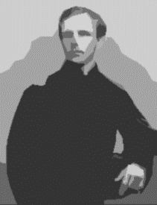
Apply Different Effects to a Painting
Founder of Hampton Normal and Agricultural Institute
Renamed Hampton Institute
Renamed Hampton University
Designed to educate the newly emancipated
Grown into a comprehensive university
Offers a range of undergraduate and graduate degree programs
Houses several historical landmarks
Known for famous alumni

Slide 17
Original Design
Modified Duplicate Design

Slide 18

Thank you for attending my lecture!

Slide 19
Questions?

